Slide 1
Factors Affecting STEM Degree Completion At Public Universities In The United States A quantitative analysis of IPEDS 2022 data Your name: Biniam Abebe Date: July 21, 2024 University of North Texas, ADTA 5410-400

Slide 2
STEM education is crucial for innovation and economic growth
What factors affect STEM degree completion rates at public universities in the United States?
Objectives:
Identify key demographic and institutional variables
Develop a predictive model for STEM completion rates
Provide insights for policymakers and educators

Slide 3
Methodology
Data source: Integrated Postsecondary Education Data System (IPEDS) 2022
Sample: 1,549 public institutions
Datasets used:
Institutional Characteristics
Completions
Charges
Analysis method: Regression
Tools: Python (pandas, scikit-learn, matplotlib, seaborn)

Slide 4
Key Findings - Descriptive Statistics
Average completion rates:
Male students: 390.35
Female students: 290.64
Ethnic disparities:
Highest: White and Asian students
Lowest: American Indian/Alaska Native students
Financial aspects:
Average tuition: $5,081.53
Range: $0 to $20,173

Slide 5
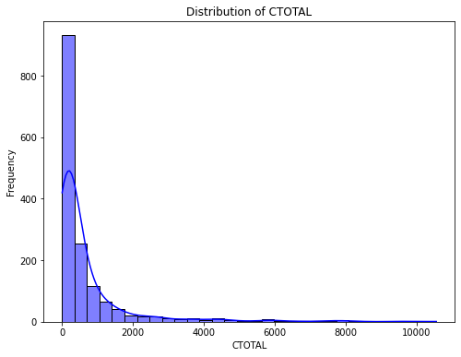
Distribution of Completions
Right-skewed pattern observed
Majority of institutions report relatively low completion numbers
A small number of institutions account for a disproportionately large number of completions
Implications for resource allocation and policy-making

Slide 6
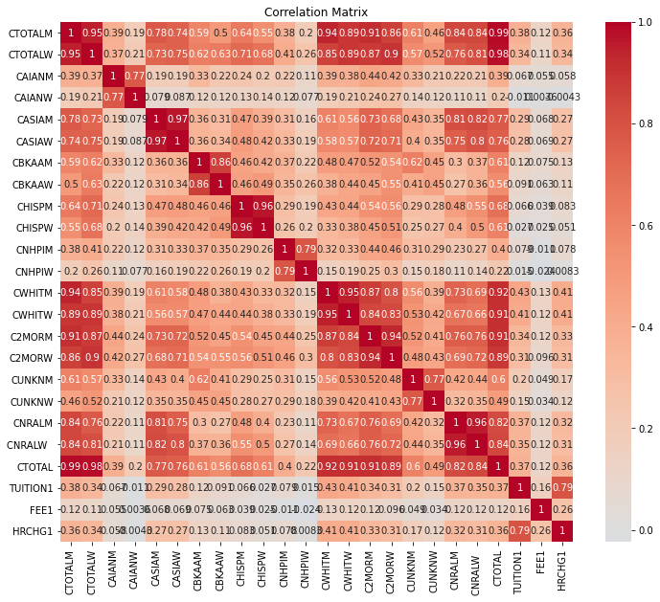
Correlation Analysis
Key correlations:
Strong positive correlations between male and female completion rates within ethnic groups (e.g., r = 0.97 for Asian students)
Total completions highly correlated with both male (r = 0.99) and female (r = 0.98) completions
Financial factors showed weak to moderate correlations with completion rates

Slide 7
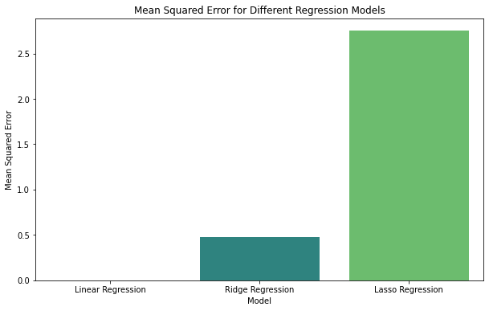
Model Results
Ridge Regression results:
Mean Squared Error: 0.47315647
R-squared: 0.999
Interpretation:
Model explains nearly all variance in STEM completion rates
Extremely high predictive power
Potential for accurate forecasting of STEM degree completion rates
Key observations:
Linear Regression: Shows the lowest MSE, very close to zero. This suggests it fits the training data extremely well, potentially overfitting.
Ridge Regression: Has a slightly higher MSE than Linear Regression, but still relatively low. This indicates it's providing some regularization while maintaining good predictive performance.
Lasso Regression: Shows the highest MSE by a significant margin, around 2.75. This suggests it's applying the strongest regularization, potentially sacrificing some model fit for better generalization.

Slide 8
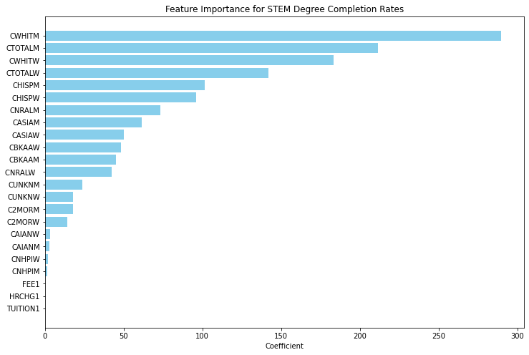
Feature Importance
Most influential factors:
White male and female completions
Total male and female completions
Hispanic/Latino student completion
Asian student completions
Surprisingly, financial factors showed minimal influence

Slide 9
Implications
Potential for accurate forecasting of STEM completion rates
Value for:
Resource allocation
Program planning
Developing targeted interventions
Insights for addressing disparities in STEM education
Guide for policymakers and educators in decision-making

Slide 10
Limitations and Future Research
Limitations:
Future Research:
Single year of data (2022)
Potential for overfitting despite Ridge Regression
Limited variables chosen from IPEDS dataset
Apply other regularization techniques eq. Elastic Net
Incorporate multi-year data for temporal analysis
Include additional external factors
Conduct out-of-sample validation

Slide 11
Conclusion
Ridge Regression model provides robust predictions for STEM degree completion rates
Key factors:
demographic composition, notably White, Hispanic/Latino, and Asian student completion
Financial factors less influential than expected
Results offer a valuable starting point for improving STEM degree completion rates
Call to action: Use these insights to develop targeted interventions and policies

Slide 12
THANK YOU
Biniam Abebe

